Slide 1
INTRODUCTION TO OPENCV
Open Source Computer Vision Library

Slide 2
What is OpenCV and its importance?
OpenCV is a huge open-source library for computer vision, machine learning, and image processing.
OpenCV supports a wide variety of programming languages like Python, C++, Java, etc.
It can process images and videos to identify objects, faces, or even the handwriting of a human.

Slide 3
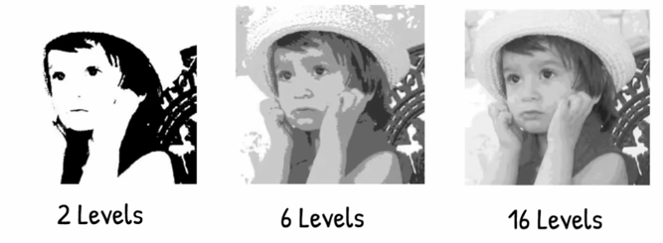
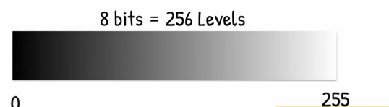
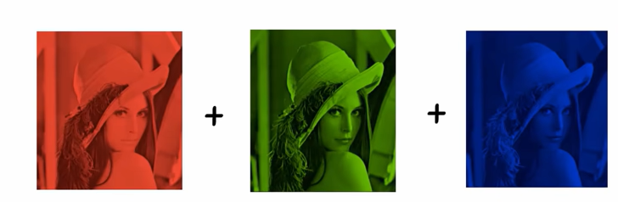
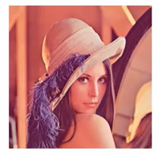
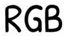

Slide 4
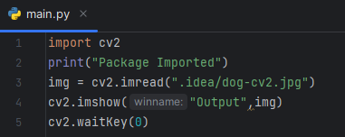
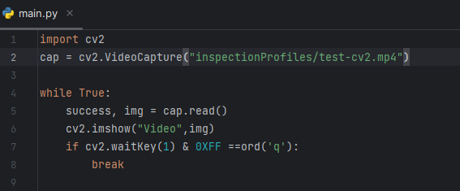
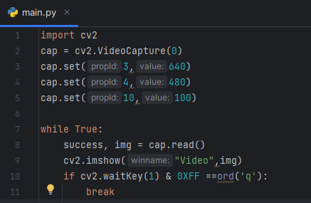
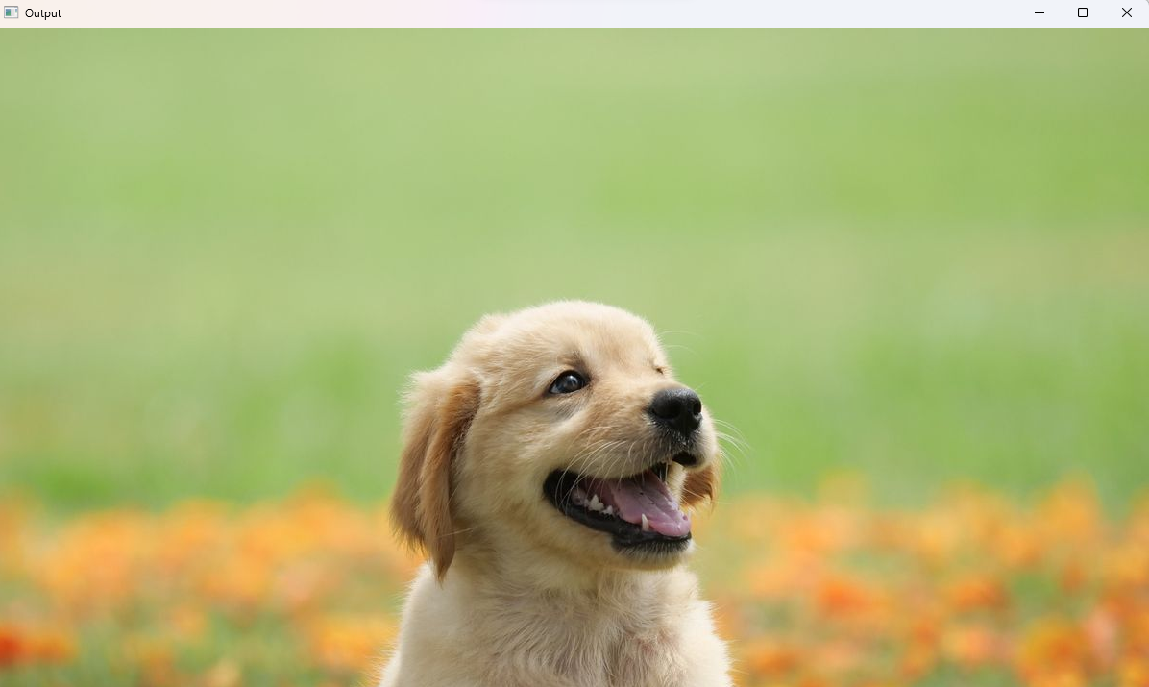
1) Reading images, videos and webcam
Cv2.imread reads the gives image || cv2.imshow is used to display the image

Slide 5
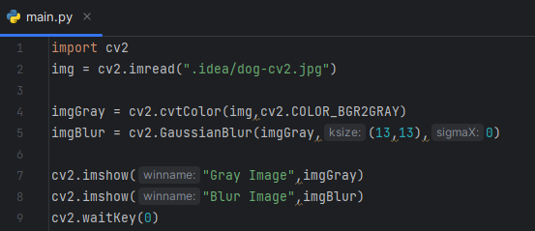
2) Basic Functions
Cv2.cvtColor is a function used to convert one colour space to another
Here it is changed to Gray
ksize: Kernel Size: Should be in odd pairs.
Cv2.GaussianBlur is used for blurring the image
Here it tells the quality of blur

Slide 6
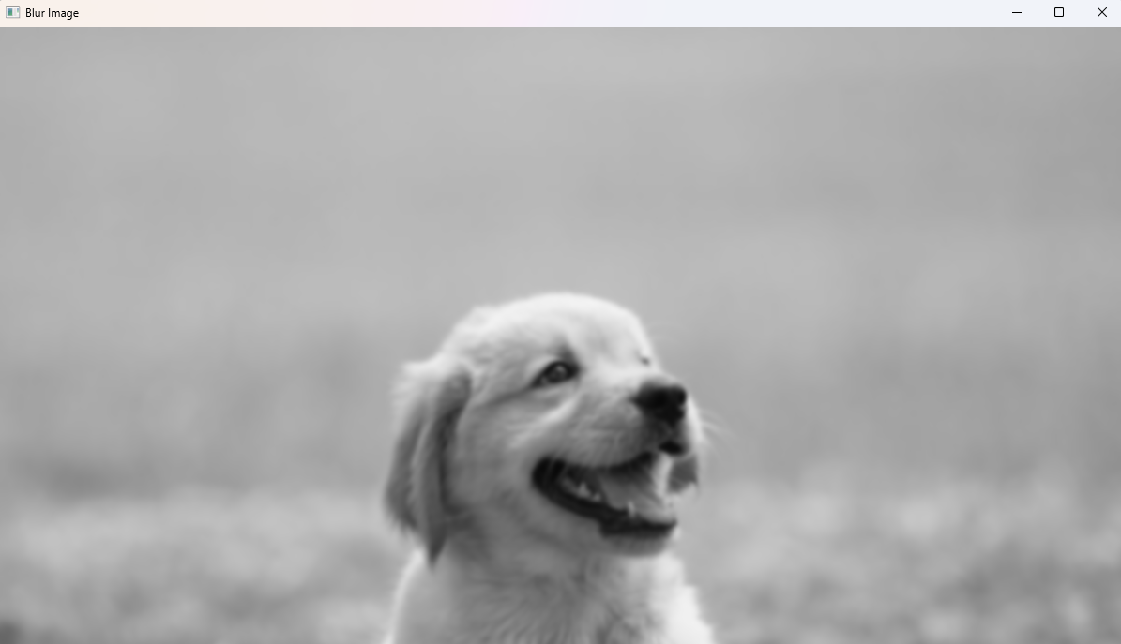
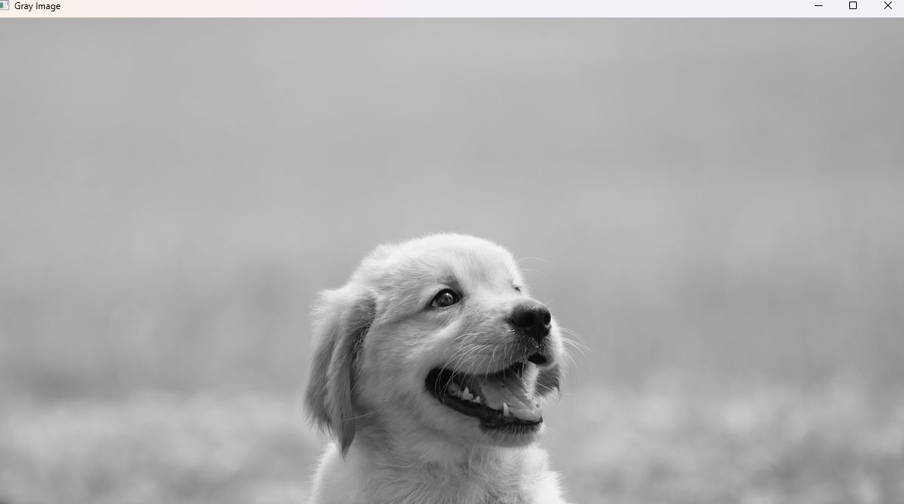

Slide 7
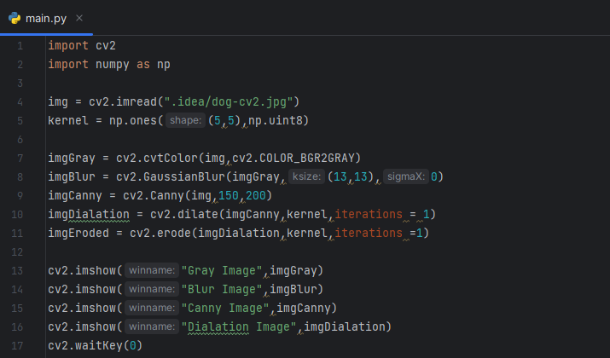
Kernel here is making a 5X5 matrix filled with ones using NumPy.
Cv2.Canny is a function used for edge detection
Cv2.Dialate is used to increase the size or thickness of white regions in binary image
Cv2.erode is used to shrink the white regions of a binary image
Iterations specifies operation should be done 1 time

Slide 8
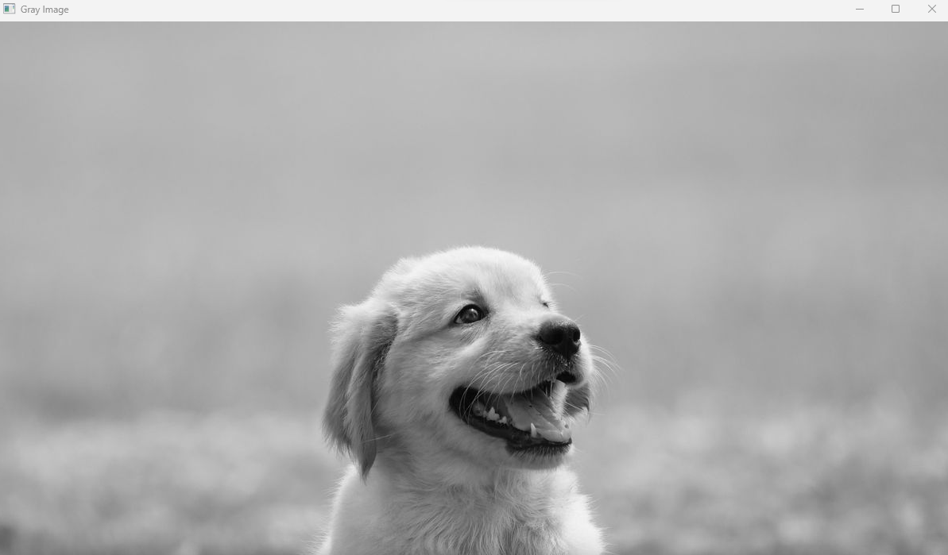
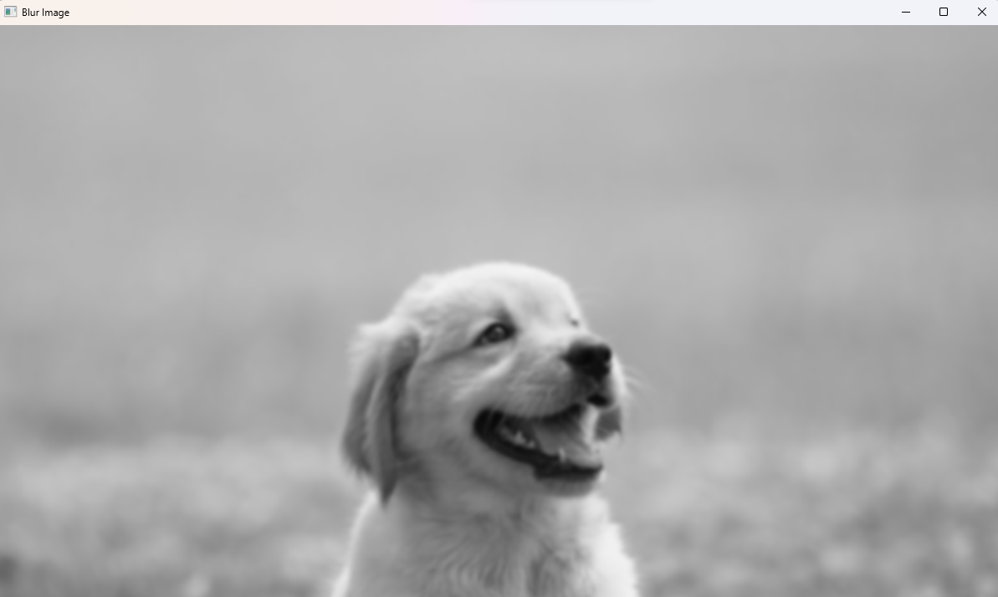
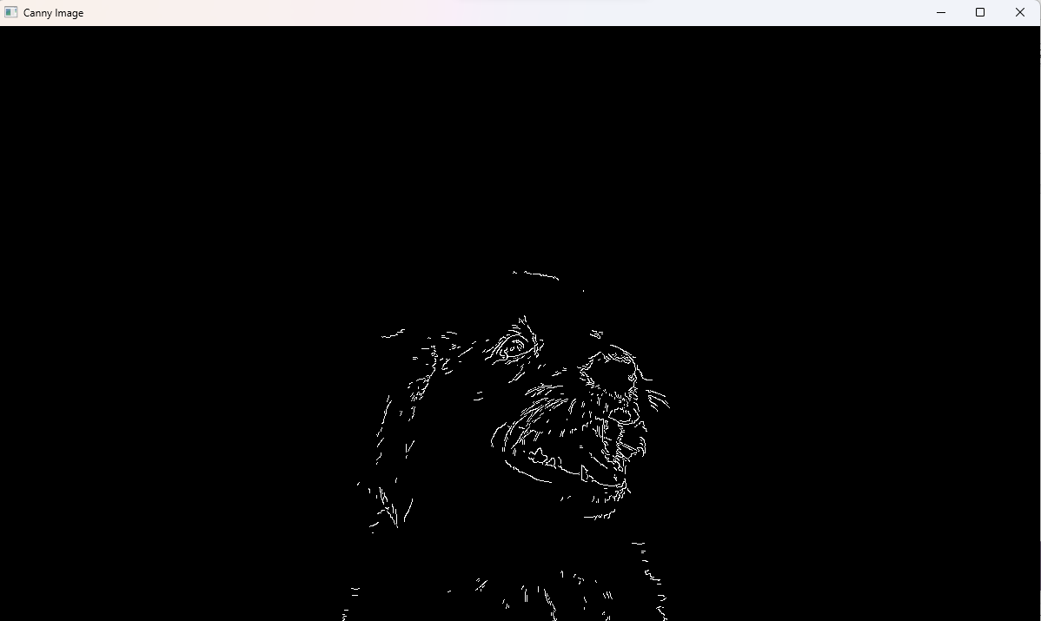
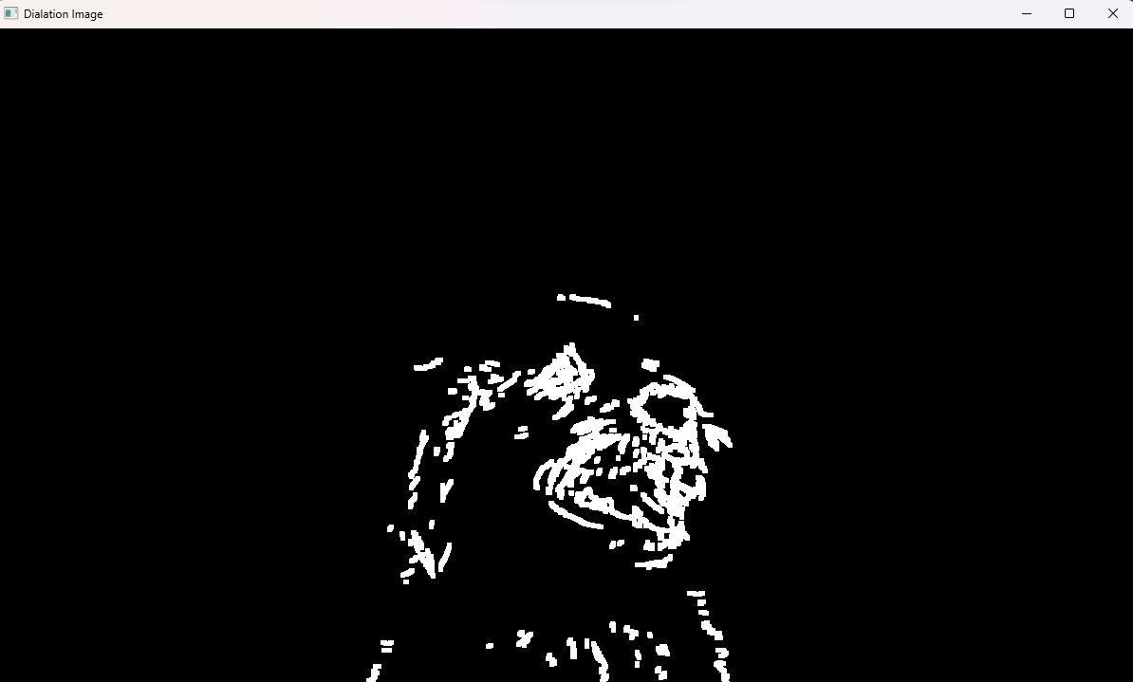
Eroded Image
Dialated Image

Slide 9
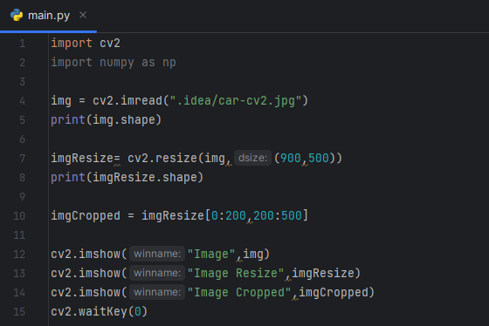
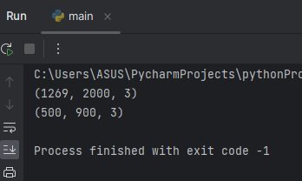
Resizing and Cropping
Cv2.resize is used to resize the image
Cv2.resize(source,size of output array)
For cropping, we are slicing the image:
row slice
column slice

Slide 10
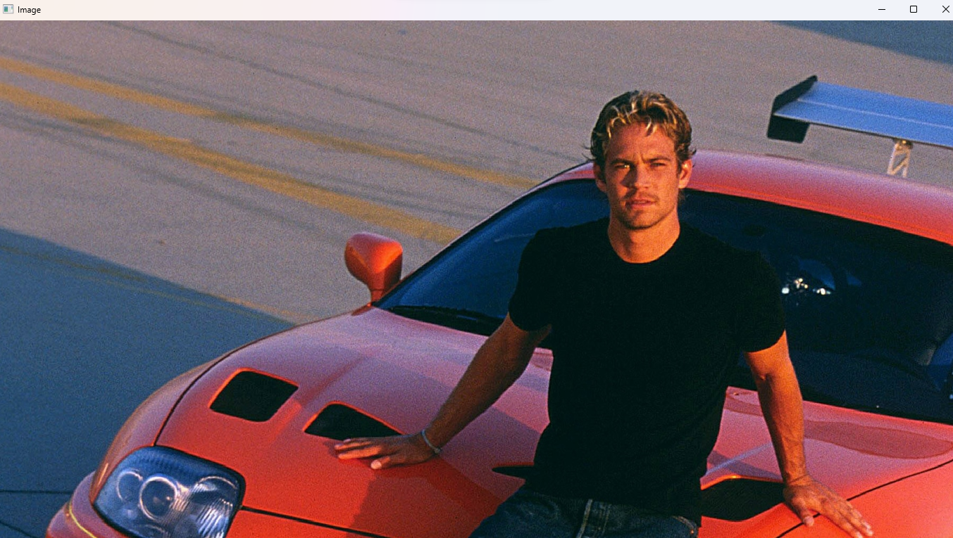


Slide 11
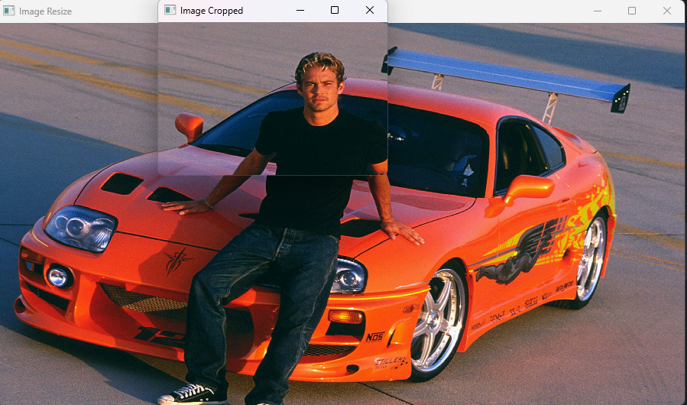

Slide 12
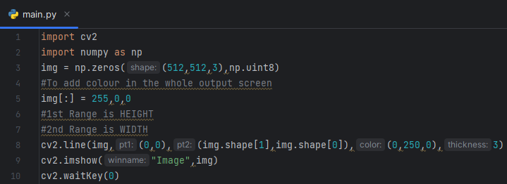
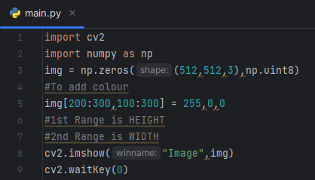
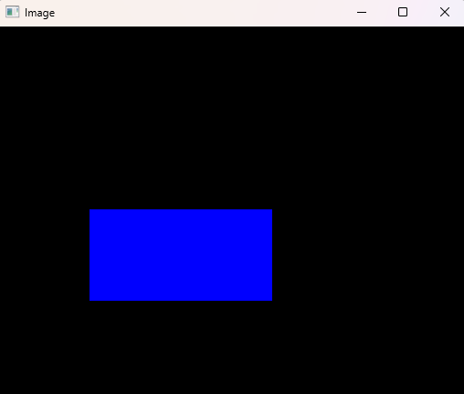
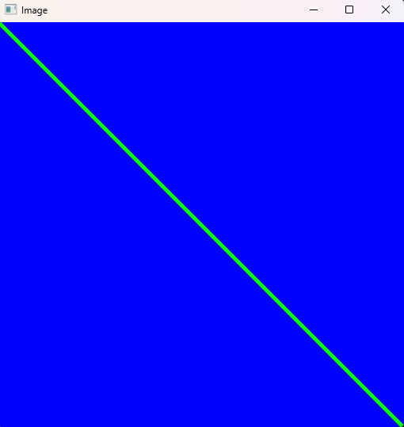
Shapes and Text

Slide 13
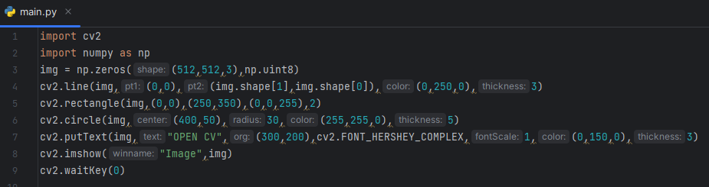
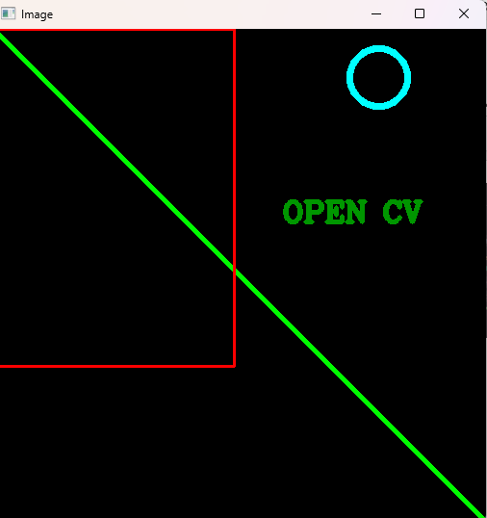

Slide 14
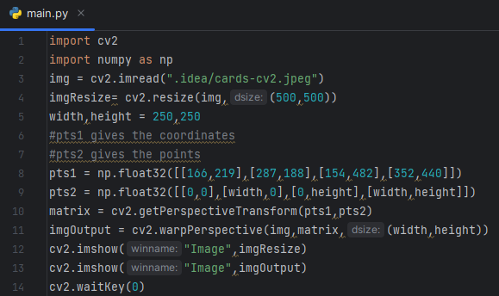

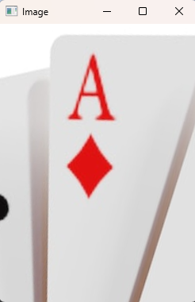
Warp Perspective
cv2.getPerspectiveTransform is used to find the point that we have given
We need matrix for inputting our perspective
We are using cv2.warPerspective to input all the above parameters with size of the image
Cv2.warpPerspective(source of image, output image size, size of image)

Slide 15
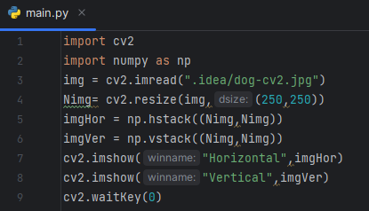
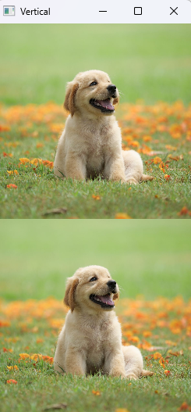
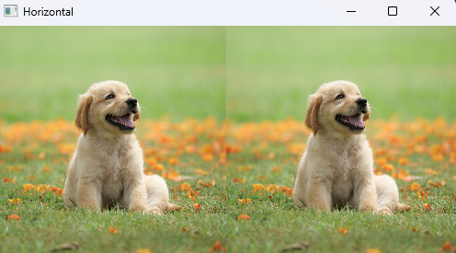
Joining Images
np.hstack is used to stack the images in horizontal manner
np.vstack is used to stack the images in vertical manner
The images should be of the same colour input

Slide 16
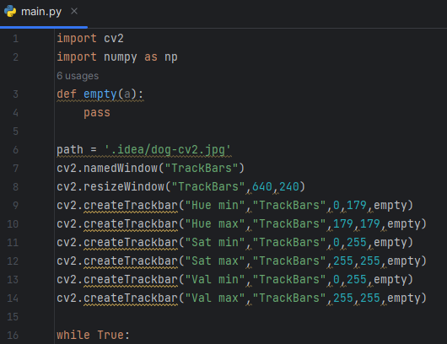
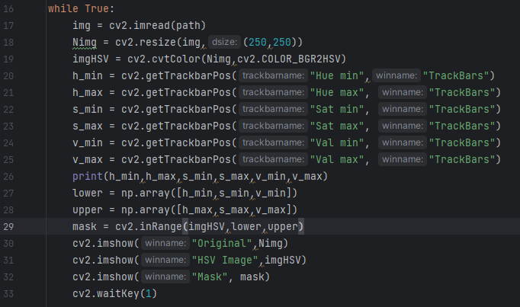
Color Detection
cv2.resizeWindow: resizing the window “TrackBars” || A loop created to run the commands again
Name of window should remain same || Mask window is inheriting the image with its lower and upper limit

Slide 17
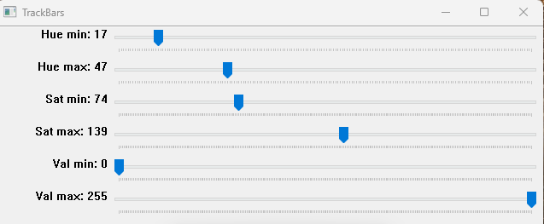
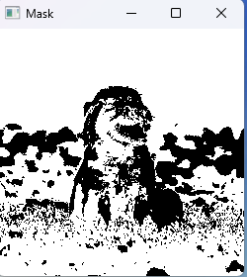
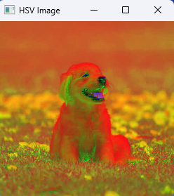
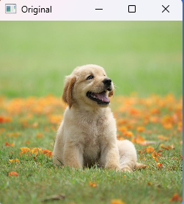

Slide 18
Face Detection
This method was proposed by someone named Viola and Jones
Positive faces are images that have faces
Negative faces are images that do not have face
Combining positive and negative faces we can combine to make a Cascade
OpenCV has its own cascades to detect different types of things not just faces.
Positive Faces
Train
XML
File
Negative Faces

Slide 19
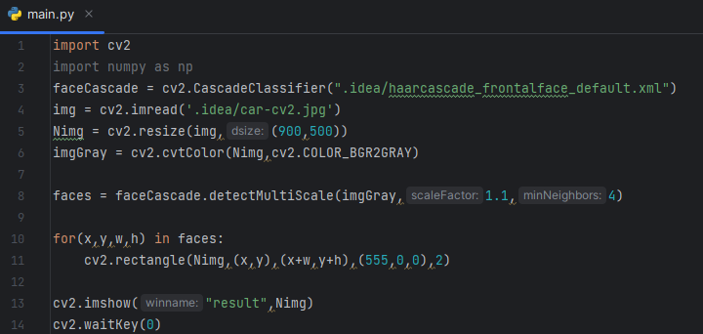
Cv2.CascadeClassifier is used to read the cascade file which has the code to detect frontal face.
faceCascade.detectMultiScale is used to find the face
cv2.rectangle is used to create a boundary box which will detect the face
Cv2.rectangle(initial points, diagonal points, colour, thickness)

Slide 20
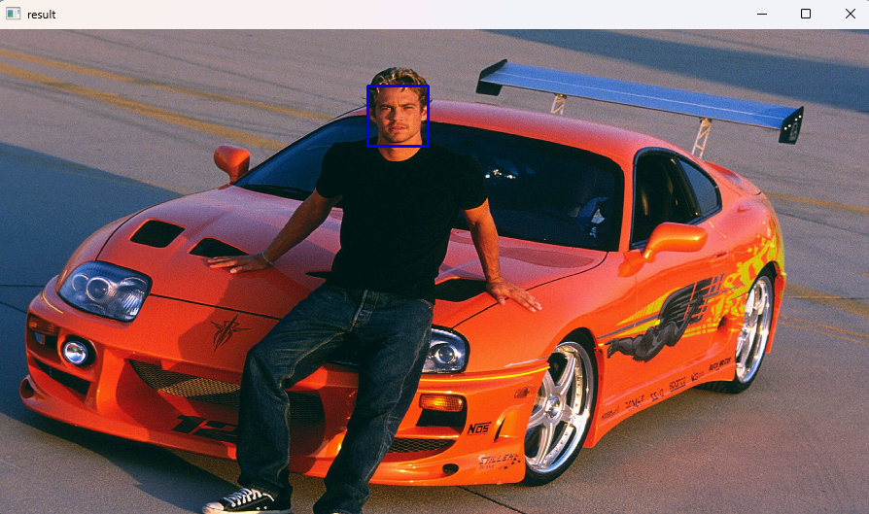

Slide 21
Thank You

